Slide 1
Experimental Results
All_IVCs Algorithm

Slide 2
Overhead of different algorithms
Algorithm | min | max | avg | stdev
All_IVCs | 21.184% | 102779.901% | 1582.580% | 5046.019%
Minimization | 0.0% | 1686.676% | 49.487% | 167.693%
IVC_UC | 0.0% | 114.141% | 10.618% | 13.513%
IVC_UCBF | 23.033% | 9738.860% | 1048.532% | 1419.658%
* Overhead = (running time of the algorithm)/ (JKind verification time) * 100

Slide 3
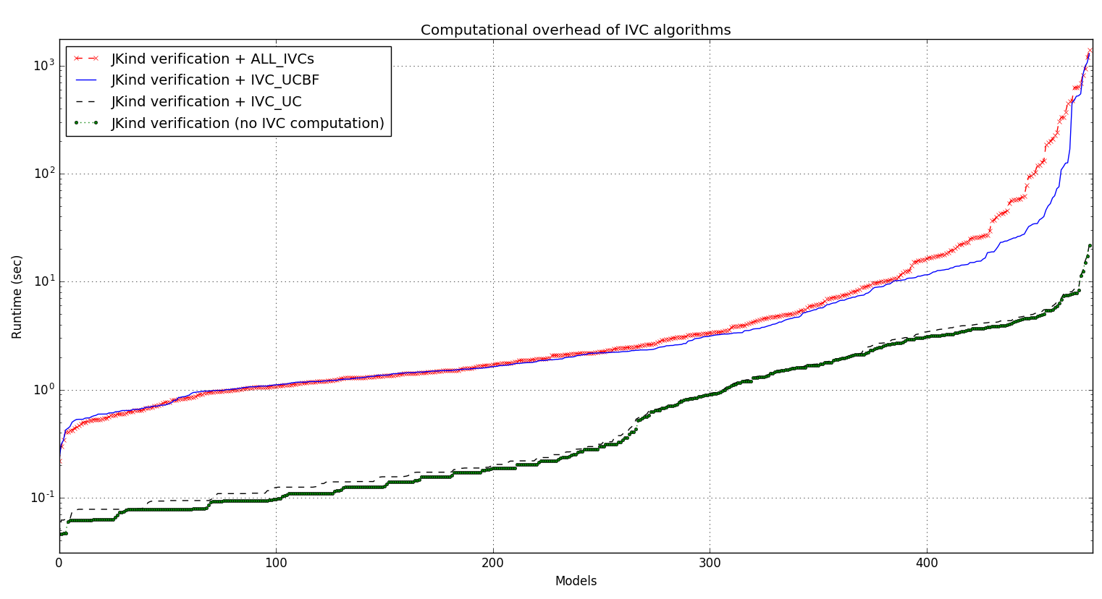

Slide 4
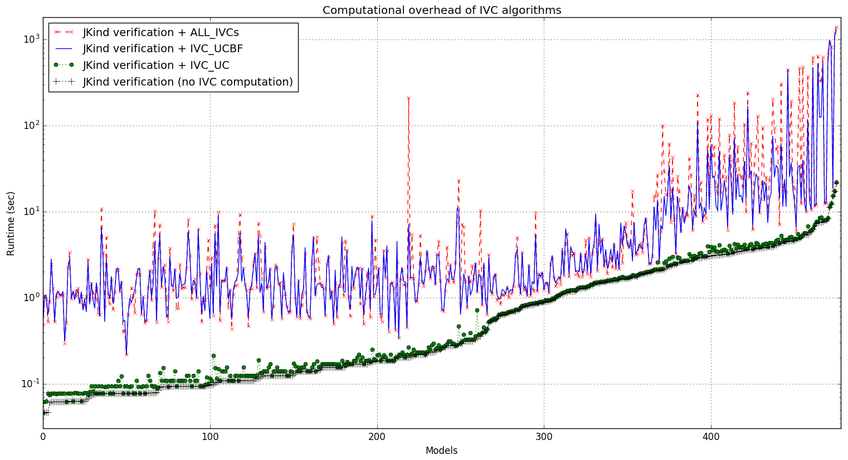

Slide 5
Running time of different algorithms
Running time (sec) | min | max | avg | stdev
All_IVCs + proof time | 0.219 | 1396.894 | 30.387 | 126.697
minimization + All_IVCs + proof | 0.219 | 1396.894 | 31.076 | 128.583
IVC_UC + proof time | 0.046 | 21.997 | 1.434 | 2.331
IVC_UCBF + proof time | 0.219 | 1286.479 | 20.776 | 108.626
Proof time | 0.046 | 21.825 | 1.351 | 2.241
All_IVCs | 0.141 | 1375.069 | 29.036 | 125.035
IVC_UC | 0.0 | 1.32 | 0.084 | 0.178
minimization | 0.0 | 106.21 | 0.689 | 5.321

Slide 6
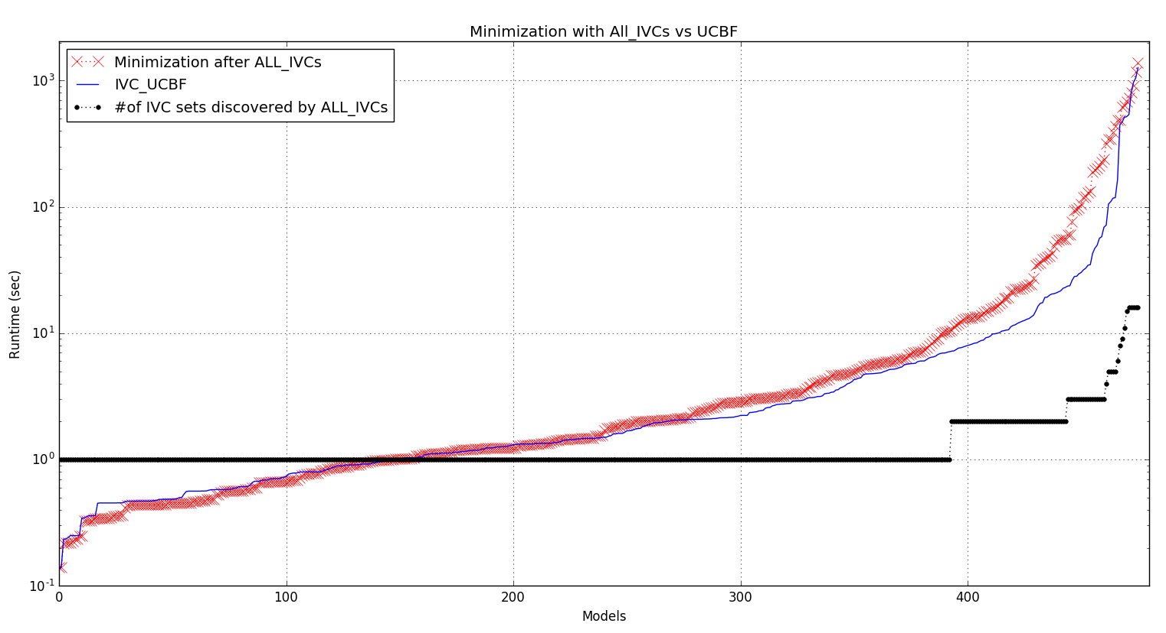

Slide 7
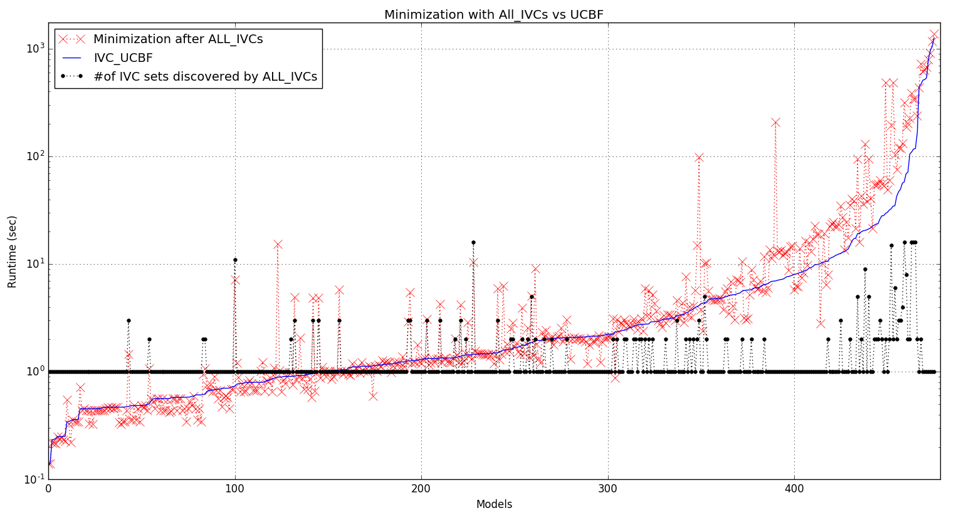

Slide 8
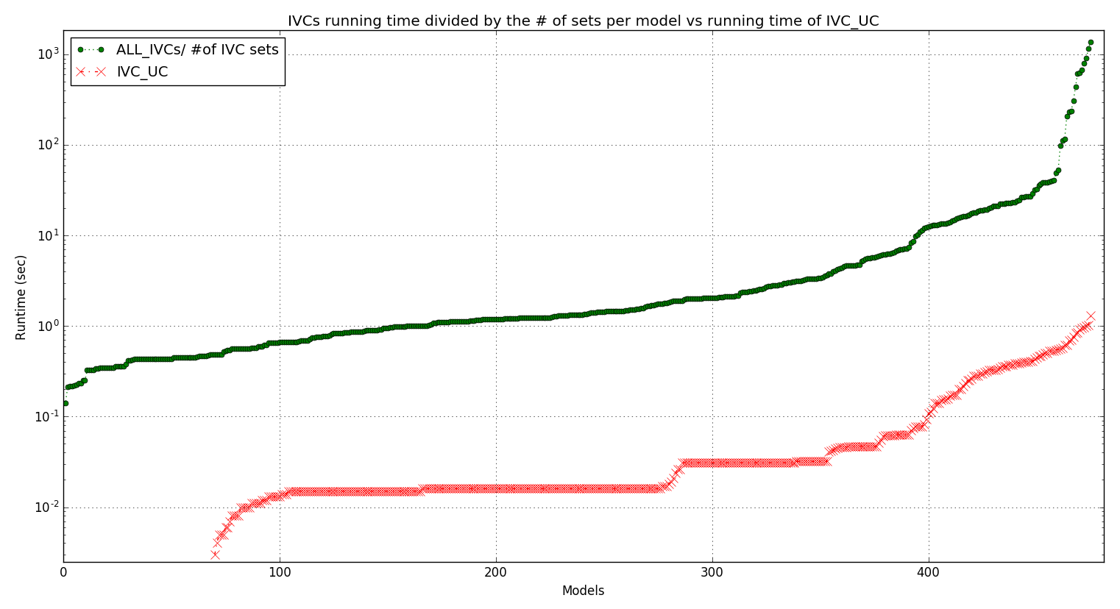

Slide 9
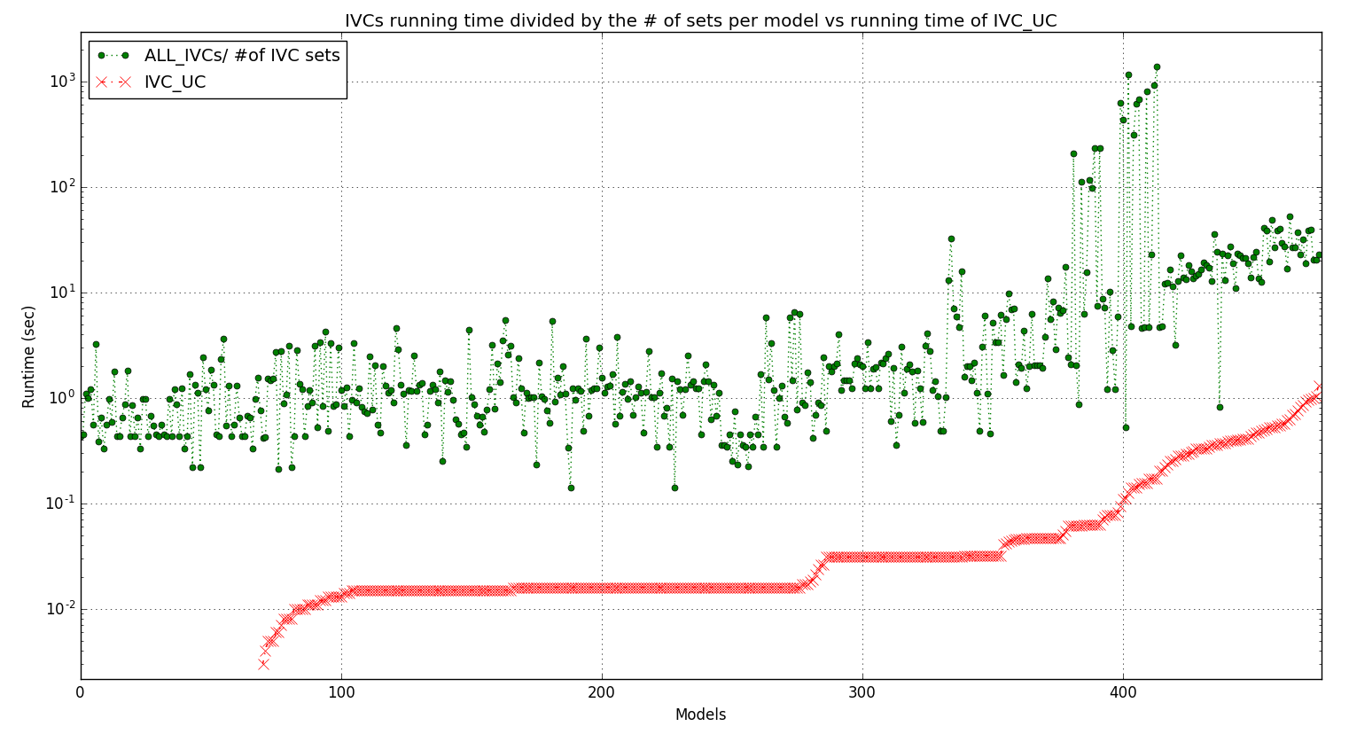

Slide 10
Info on IVC_UCBF minimization runs
Running time (sec) | avg | stdev
All runs among all models | 0.89 | 7.88
VALID runs among all models | 2.55 | 0.44
INVALID runs among all models | 0.21 | 0.92
UNKNOWN runs among all models | 126.91 | 0.81

Slide 11
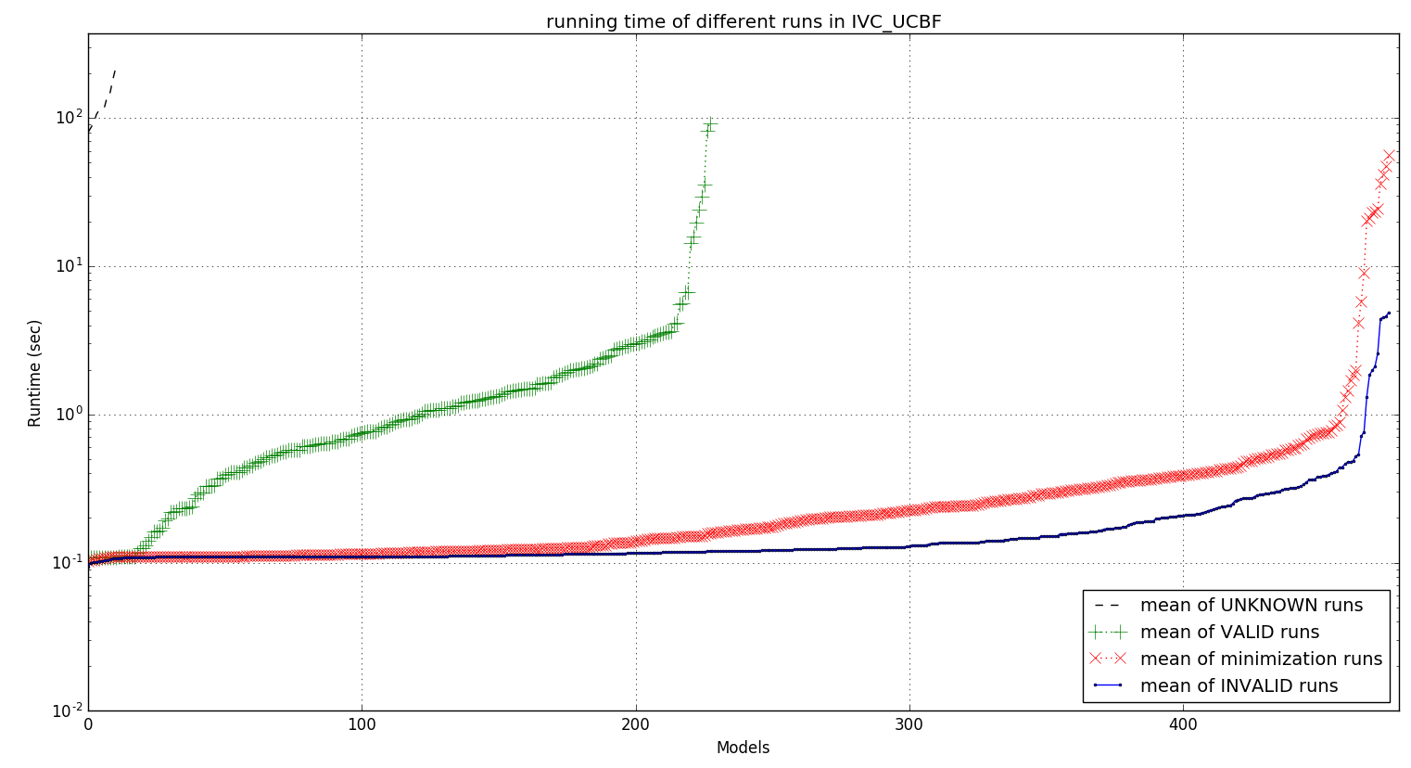

Slide 12
